Slide 1

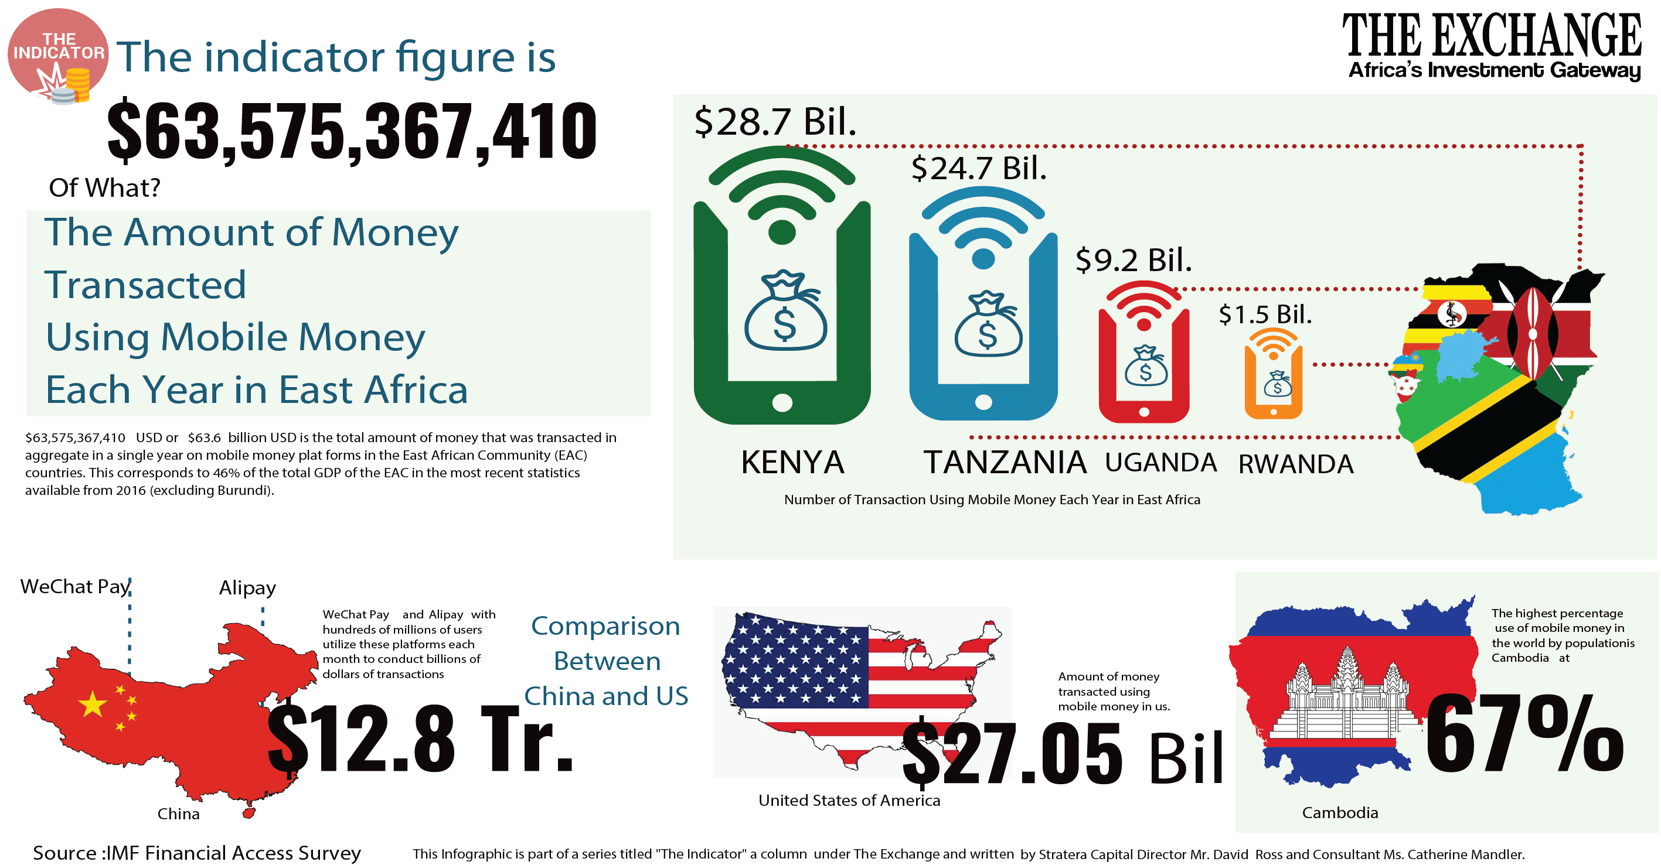
FRAUD DETECTION AUGUST 21, 2019 UFT – 3253_029 – Machine Learning – Group #9 VijayAN ALAGUDEVAN Sabarinathan selvaraj VinodH KUMAR AIYAPPAN SATISH SUBRAMANIAN

Slide 2
Agenda
Problem Statement
Approach
Source Data
Data Analysis
Machine Learning Model
Conclusion
Next Steps
Appendix

Slide 3
1. Problem Statement
Along with the great increase in online mobile money transactions, fraud has become increasingly rampant in recent years.
Fraud is one of the major causes of great financial losses and financial institutions are advancing their capability to detect fraud.
The objective of this project is to develop machine learning model to detect mobile money transaction fraud and verify whether balancing the dataset helps in improving the predictability.
Why Mobile Money Transactions is Susceptible to Fraud?
Developing economies are relatively under banked but have in the last few years achieved very high mobile penetration rates. Mobile Money implies far greater risks. Some of the reasons for this are listed below:
Mobile Money involves direct cash in flows and out flows between external entities such as clients, merchants or banks. Transaction data flows through multiple parties and tracking usage could be quite a daunting task.
Transactions may have very small values and hence go undetected in traditional Suspicious Activity Reports or High Usage Reports.
1

Slide 4
2. Approach
Analyze using Decision tree & Random forest classification models using unbalanced data
Balance dataset & run models
Data exploration & Feature selection
Compare AreaUnderPR/AUC for both models
Compare Confusion matrix for both models & verify if balanced data produces better results
2

Slide 5
3. Source data
Why we choose this Data?
Lack of legitimate datasets on mobile money transactions to perform research in domain of fraud detection is a big challenge.
PaySim is a financial simulator that simulates mobile money transactions based on an original dataset.
PaySim simulates mobile money transactions based on a sample of real transactions extracted from one month of financial logs from a mobile money service implemented in an African country.
The original logs were provided by a multinational company, who is the provider of the mobile financial service which is currently running in more than 14 countries all around the world.
Data Dictionary
Column Name | Description
step | Maps a unit of time in the real world. In this case 1 step is 1 hour of time. Total steps 744 (30 days simulation)
type | CASH-IN, CASH-OUT, DEBIT, PAYMENT and TRANSFER
amount | Amount of the transaction in local currency
nameOrig | Customer who started the transaction
oldbalanceOrg | Initial balance before the transaction
newbalanceOrig | New balance after the transaction
nameDest | Customer who is the recipient of the transaction
oldbalanceDest | Initial balance recipient before the transaction. Note that there is not information for customers that start with M (Merchants)
newbalanceDest | New balance recipient after the transaction. Note that there is not information for customers that start with M (Merchants)
isFraud | Labelled data categorized as Fraud
Source: https://www.kaggle.com/ntnu-testimon/paysim1
3

Slide 6
3. Source data (Contd/-)
Data Dictionary (Contd/-)
Below is the summary of three main agents in the system:
Clients are the normal customers of the system
Merchants play a passive role during the simulation and only serve the clients in certain operations
Fraudsters are the threat to the system and the principal focus of our study in fraud detection
Data Definition
CASH-IN is the process of increasing the balance of account by paying in cash to a merchant.
CASH-OUT is the opposite process of CASH-IN, it means to withdraw cash from a merchant which decreases the balance of the account.
DEBIT is similar process than CASH-OUT and involves sending the money from the mobile money service to a bank account.
PAYMENT is the process of paying for goods or services to merchants which decreases the balance of the account and increases the balance of the receiver.
TRANSFER is the process of sending money to another user of the service through the mobile money platform.
4

Slide 7
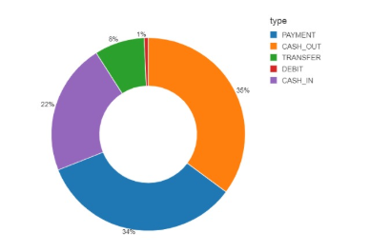
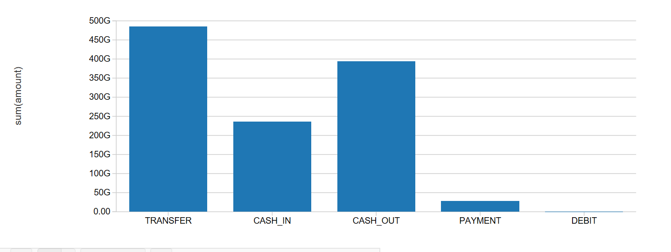
4. DATA Analysis
Total data | 6.3 million (6,354,407)
Fraud (#s, %) | 8,213 (0.13%)
# of columns | 10
Period collected | One month
Missing values | Yes
Problem type | Supervised - Binary Classification
Data is heavily unbalanced which is the usual case with fraudulent transactions.
Analysis of Transaction types (amount)
Transactions associated with Fraud
5

Slide 8
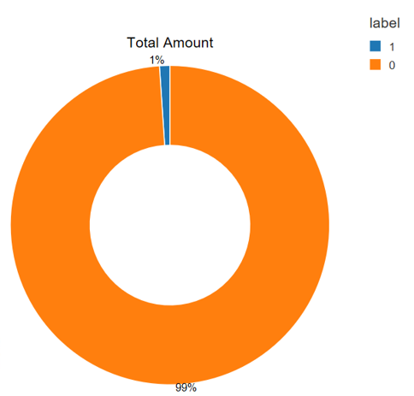
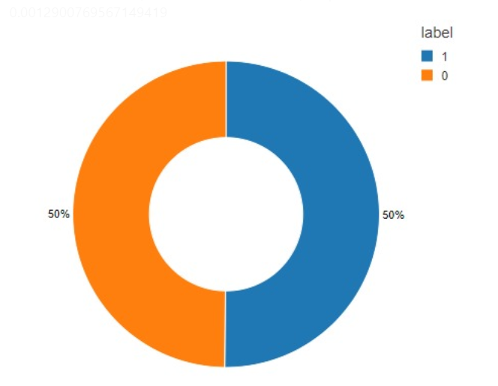
4. DATA Analysis (Contd/-)
Unbalanced Data
Total Transactions : 6,354,407
Fraud : 8,213
Why Weighing was performed?
Weighting is a procedure that weights the data to compensate for differences in sample and population.
In this case, we would assign a weight of 1 for fraud transactions and a weight of # legitimate/ # fraud for legitimate transactions. This is called the Weighted Maximum Likelihood method.
The important takeaway is that the weighting is related to sampling proportions.
Balanced Data
Total Transactions : 16,426
Fraud : 8,213
6

Slide 9
5. Machine Learning Modeling Approach
Train/Test Split Data*
ML Pipeline/Scaling
ML Model
Train Model
Weighing
Compare models & evaluate results
Re-evaluate Model
*80 Train/20 Test
7

Slide 10
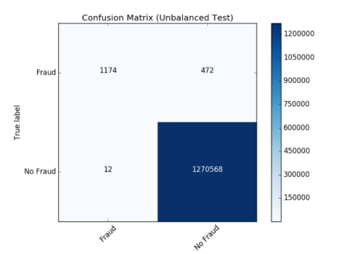
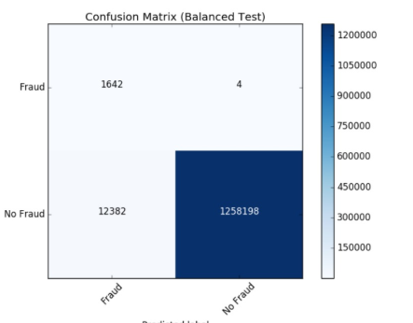
5. Model – random forest
Random Forest algorithm can be used for both classifications and regression task. It provides higher accuracy.
Random forest classifier will handle the missing values and maintain the accuracy of a large proportion of data.
If there are more trees, it won’t allow overfitting trees in the model. It has the power to handle a large data set with higher dimensionality.
Unbalanced Data
PR train: 0.8463088093499616
AUC train: 0.853049407168464
PR test: 0.8481402757387393
AUC test: 0.8566173919634524
Balanced Data
PR train: 0.9940902637944411
AUC train: 0.9965578157621837
PR test: 0.11144421228336024
AUC test: 0.9927432988717257
8

Slide 11
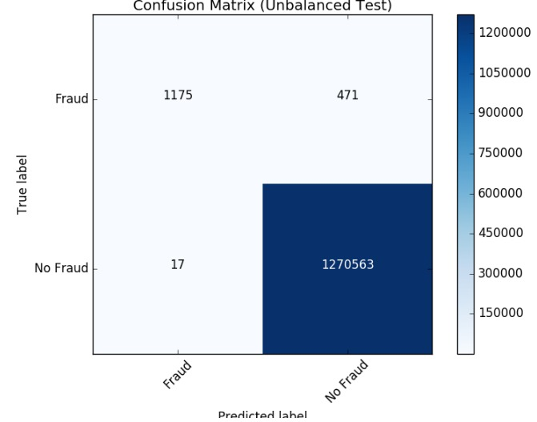
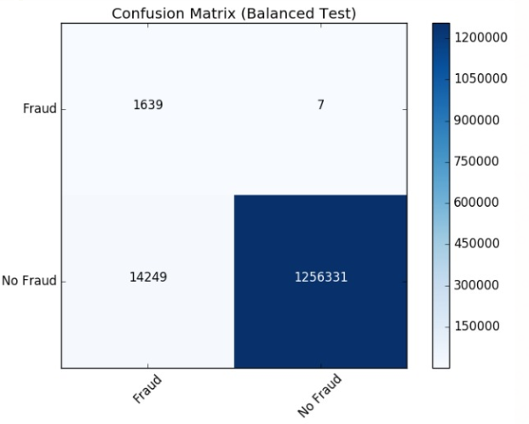
5. Model – DECISION TREE
Decision Trees and their ensembles are popular methods for the machine learning tasks of classification and regression.
Decision trees are widely used since they are easy to interpret, handle categorical features, extend to the multiclass classification setting, do not require feature scaling, and are able to capture non-linearities and feature interactions. Tree ensemble algorithms such as random forests and boosting are among the top performers for classification and regression tasks.
Unbalanced Data
PR train: 0.8495183588351729
AUC train: 0.8553340469367771
PR test: 0.8448897311752142
AUC test: 0.8569191910652758
Balanced Data
PR train: 0.9937860382615623
AUC train: 0.9961766930154042
PR test: 0.1029430132039173
AUC test: 0.9922663513359548
9

Slide 12
6. conclusion
By performing classification on as-is data and by assigning weight, we are reducing the False Positive which is acceptable (i.e., we are reducing the number of actual fraud transactions that get predicted as legitimate).
The recall rate (i.e., True Positive Rate) has also increased from ~1150 to ~1650 which indicates that fraud prediction became accurate.
10

Slide 13
7. Next steps
Conduct deep-dive with Fraud SMEs.
Identify larger dataset with a greater number of fraudulent cases that can help to train the algorithm to make predictions with greater accuracy.
Evaluate with different ML models.
Explore mechanism to overcome missing data.
A
B
C
D
11

Slide 14
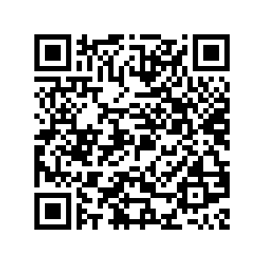
Appendix - Reference
CLICK ME HERE for code, presentation materials and video:
https://github.com/sabarinathanks/MachineLearning/tree/master/FraudDetectionTermProject
Reference:
https://www.kaggle.com/ntnu-testimon/paysim1
Fraud Detection using Machine Learning; Oza, A; Stanford University [Accessed Aug 2, 2019]
Paysim: a financial mobile money simulator for fraud detection; Lopez-Rojas, E and et al; The Norwegian University of Science and Technology [Accessed Aug 3, 2019]
12

